Slide 1
IMDB Movies Visualization
File created on: 3/25/2023 6:40:08 AM

Slide 2
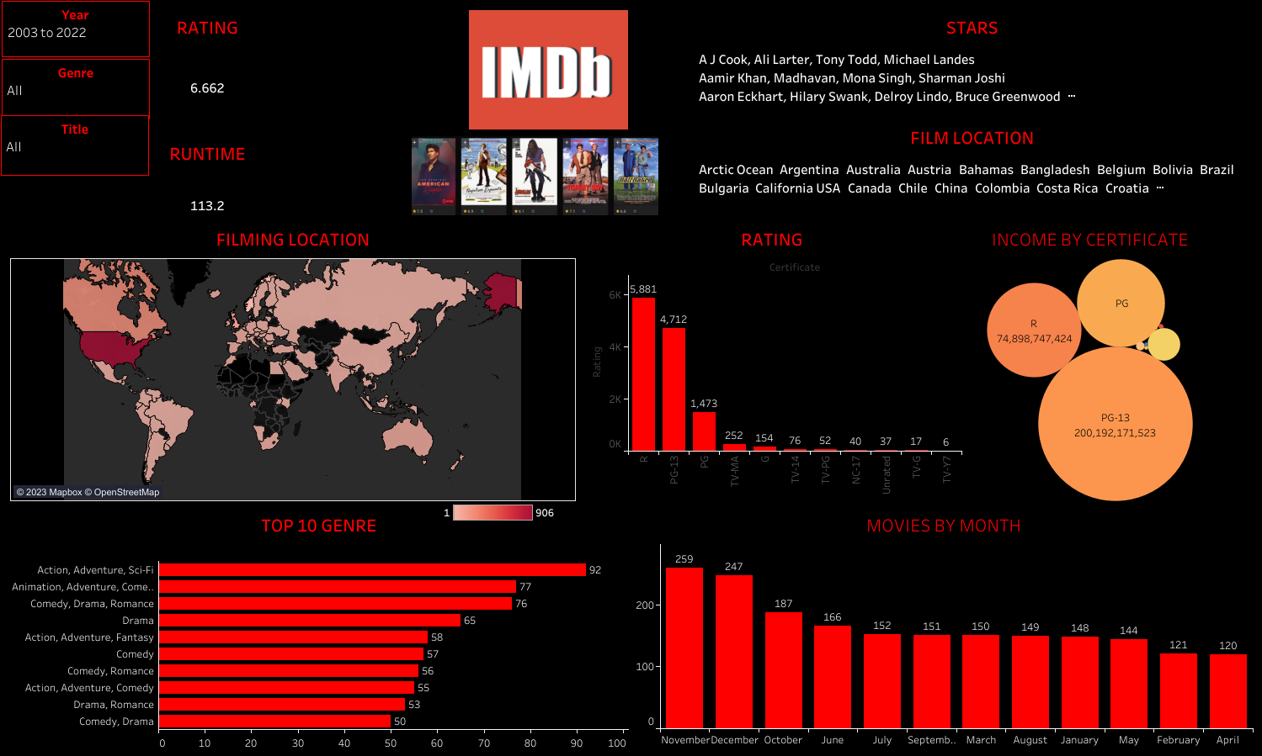

Slide 3
REFERENCE
Dataset:
https://www.kaggle.com/datasets/georgescutelnicu/top-100-popular-movies-from-2003-to-2022-imdb
Dashboard:
https://public.tableau.com/app/profile/egunjobi.tunde.fahd/viz/IMDBMoviesVisualization/IMBD

